Slide 1
The Key to the Success of Independent Games
University of Pittsburgh
Ben Ying
INFSCI 2205(2181)

Slide 2
Introduction
Supporting Arguments
Contents
significance of immersion
potential of story design
developers’ ability
Counterarguments
social attributes
no one cares about the story
Conclusion
References

Slide 3
Part 1 Introduction
The immersion and games.
The key to the success of Independent games.
You’re awake or
still dreaming?
The market is going up day by day.

Slide 4
02
Part Two
Supporting Arguments

Slide 5
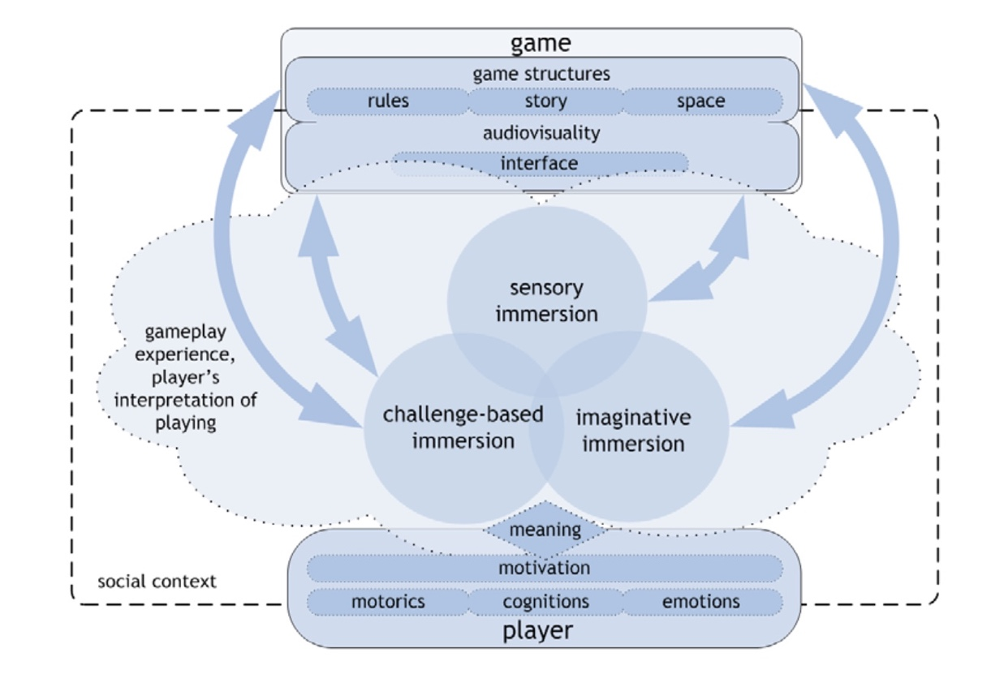
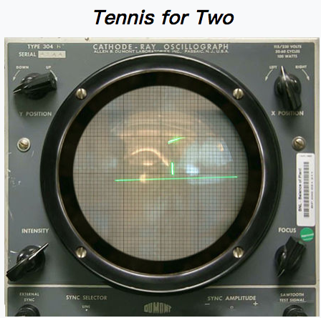

2-1 significance of immersion
Playstation VR
The history of video games
Tennis for Two in 1948
Games in 2017
The gameplay experience
Fundamental components of gameplay
Different kinds of immersion
gameplay experience model (Ermi and Mäyrä, 2005)

Slide 6
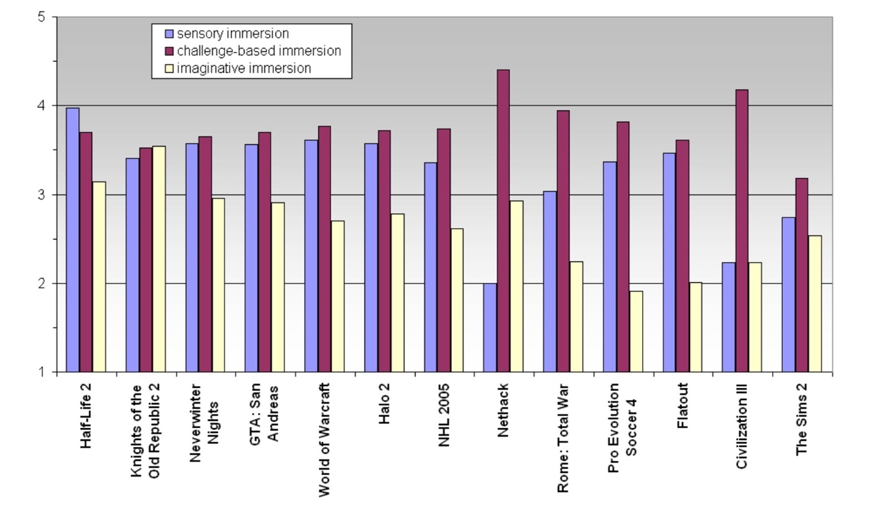

Slide 7
2-2 potential of story design
Brief Summary
1. The developments of games relates to the technology development and the atmosphere
2. From an overall perspective, the imaginative immersion is always at a low level.
3. Players create the story.
The average score of each immersion type(Ermi and Mäyrä, 2005)

Slide 8


2-2 potential of story design
These games tell good stories
Welcome to a grim dystopian future. A totalitarian State controls every aspect of private and public life. Laws are oppressive. Surveillance is total. Privacy is dead.
Two doctors try to fulfill the dream of an elderly man and seek to find out why his dying wish to go to the moon.

Slide 9
2-3 developers’ ability
· Less is More
Higher
productivity
Error
Density
39%
0.07
· Difficulty of development
· Compromise on sensory immersion and challenge-based immersion

Slide 10
03
Part Three
Counterarguments

Slide 11

3-1 social attributes
The basic element in games
Players need cooperation and communication to achieve targets.
Mobile games are social software with game functions.
Friendship could be a part of a story
The Wizard of Oz
The scarecrow, lion and tin man

Slide 12






3-2 no one cares about the story
Gaming becomes mobile.
Easy and interesting are the keys to attracting players.
Q: How to make games keep hot?

Slide 13

Part 4 Conclusion
I hope there will be more and more excellent games like the beholder and to the moon.
As independent developers, a game dominated by story can shape the future.

Slide 14
CITE SOURCES
Immersed in virtual world and minds(Bormann & Greitemeyer ,2015)
Fundamental components of the gameplay experience: Analysing immersion(Ermi & Mäyrä , 2005)
Game design as narrative(Jenkins ,2004)
Games telling stories(Juul,2001)
Software project survival guide(McConnel ,1998)
Thank you!

